Slide 1

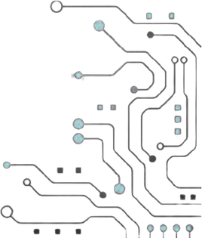




TEAM NAME : NANO NAVIGATORS
PROBELM STATEMENT NO: 01
PROBLEM STATEMENT TITLE: Design and Verification of a Low- Power Clock Gating Controller for Mobile SoC
PS Category- Software

Slide 2
Problem Statement
Real-world problem:
Idle SoC blocks still receive the clock, wasting power.
Mobile devices need to turn off clocks to unused blocks.
Clock gating must happen without glitches or unwanted clock pulses.
Why it Matters :
Reduces overall power consumption.
Improves battery life in mobile devices.
Reduces heat and improves SoC reliability
Current challenges :
Handling asynchronous wake-up without clock glitches.
Maintaining clock duty cycle and low gating latency.
Achieving zero setup and hold violations after physical implementation.

Slide 3
yOur Solution
Project name : Low-Power Clock Gating Controller for Mobile SoC
One-line solution : A glitch-free clock gating controller that turns OFF the clock of inactive SoC blocks and safely wakes them when required.
How it solves the problem:
ICG cells provide glitch-free clock gating.
Enable-based gating reduces dynamic power in idle blocks.
2-FF synchronizer ensures safe asynchronous wake-up

Slide 4
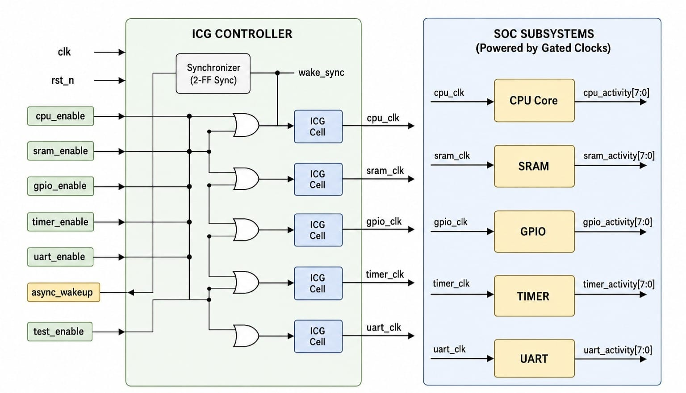
Architectural Block Diagram

Slide 5
Purpose of Blocks
Block Type | Blocks in Diagram | Purpose
Input Block | clk, rst_n, enable signals, async_wakeup, test_enable | To collect required control and status inputs.
Processing Block | Synchronizer, Logic Gates, ICG Cells | To analyze inputs and generate glitch-free gated clocks.
Output Block | CPU, SRAM, GPIO, TIMER, UART and their activity outputs | To provide the final result through functional operation and activity status.

Slide 6
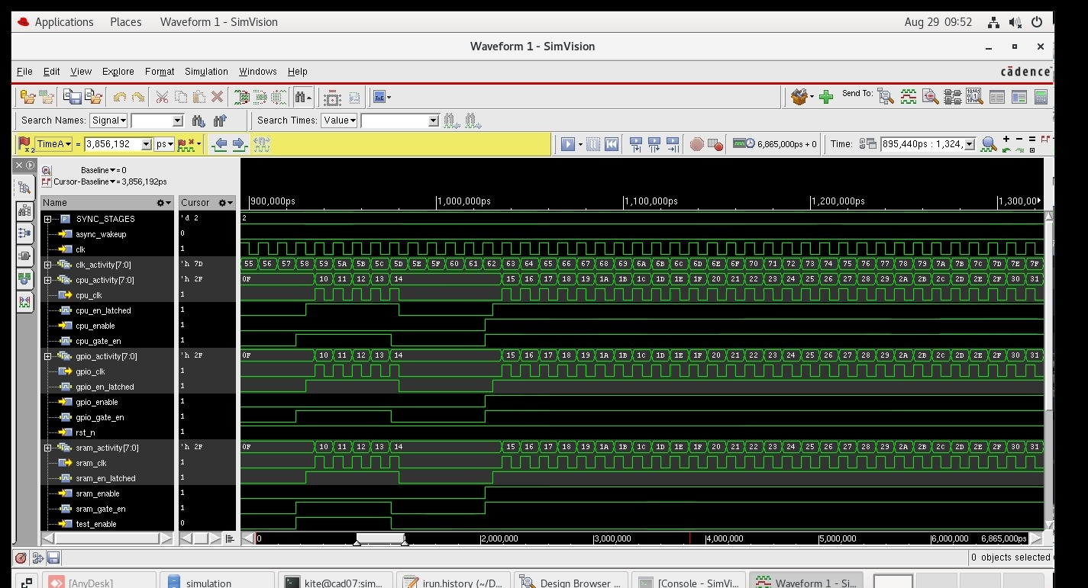
OUTPUT

Slide 7
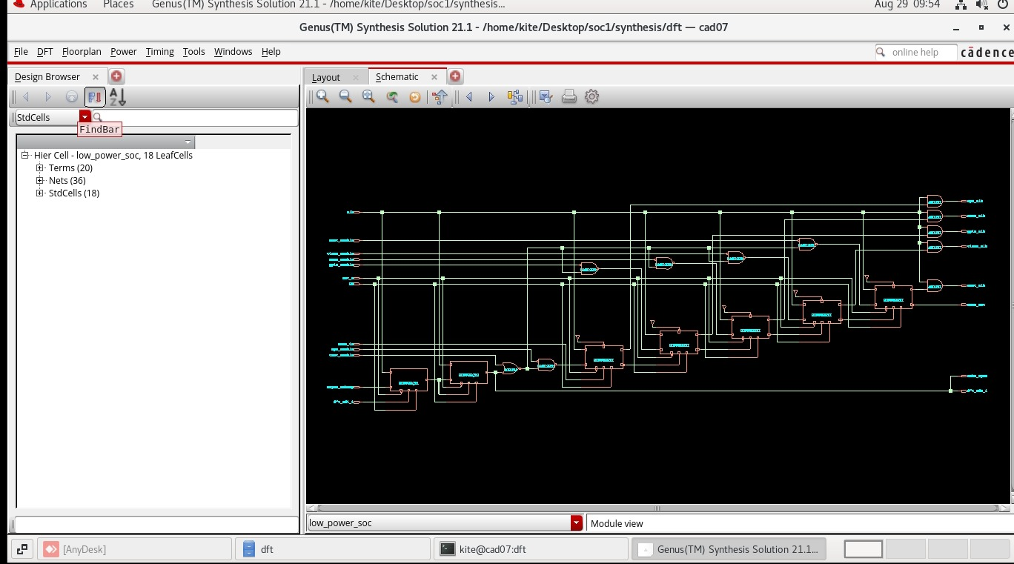
SYNTHESIS OUTPUT

Slide 8
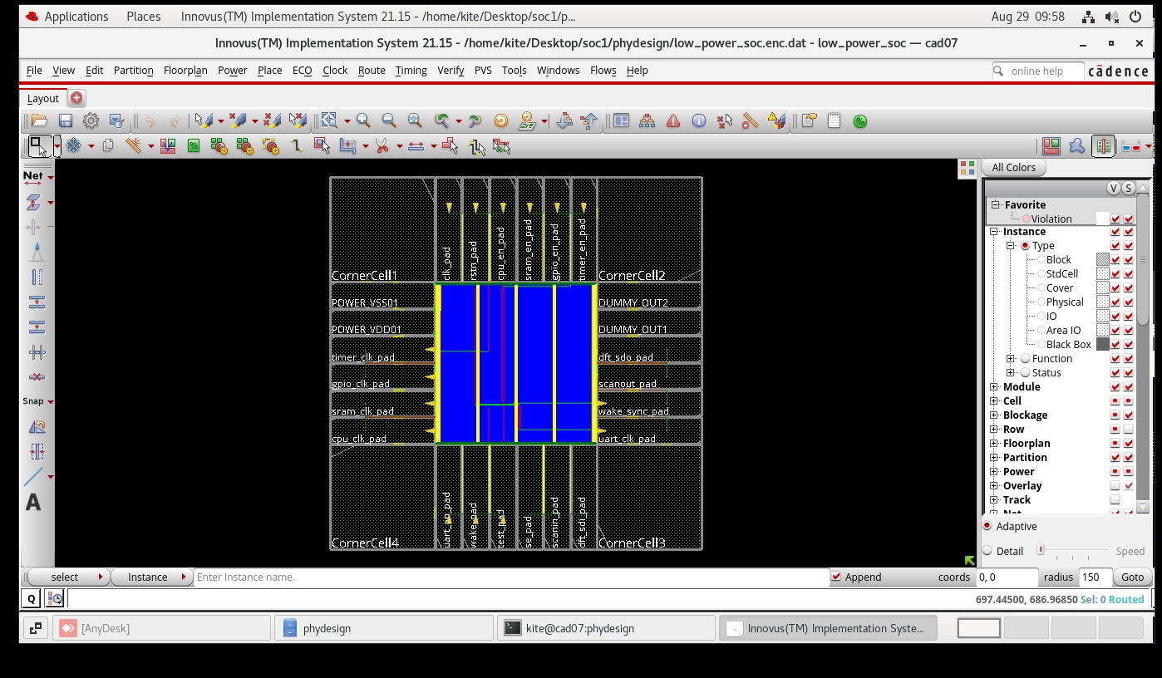
PHYSICAL DESIGN OUTPUT

Slide 9
RESEARCH AND REFERENCEs
1.S. Kalale, S. K. Panda, M. G. Asuti and S. D, "Design and Verification of a Glitch-Filtered Clock Gating Controller Using System Verilog," 2026 International Conference on Intelligent and Innovative Technologies in Computing, Electrical and Electronics (IITCEE), Bangalore, India, 2026, pp. 1-5, doi: 10.1109/IITCEE67948.2026.11394610. keywords: {Power demand;Simulation;Switches;Logic gates;Stability analysis;System-on-chip;Reliability;Hardware design languages;Field programmable gate arrays;Clocks;Glitch Filter;dynamic power;Cadence;SoC's;FPGA;optimized area;filtered signal;gated clock}
2.Malladhi, Nagarjuna, and Girish V. Attimarad. "Design and development of low power NoC architecture using clock gating technique for SoC applications." Engineering Research Express 7.2 (2025): 025316.
3. Prabhu, B., and Second Year BE ECE. "A Review of Low Power Design Techniques in System-on-Chip (SoC) Architectures."
4. J. -G. Lee, Y. Choi, H. Jeon, J. -J. Lee and D. Shin, "Fully Automated Hardware-Driven Clock-Gating Architecture With Complete Clock Coverage for 4 nm Exynos Mobile SOC," in IEEE Journal of Solid-State Circuits, vol. 58, no. 1, pp. 90-101, Jan. 2023, doi: 10.1109/JSSC.2022.3219410. keywords: {Clocks;Phase locked loops;Behavioral sciences;Power system dynamics;Optimization;Power dissipation;Power demand;Clock;dynamic power consumption;power control;power;system-on-chip (SOC)}
5. Su, Han, Jianbin Liu, and Yanfeng Jiang. "A 40-nm low-power WiFi SoC with clock gating and power management strategy." International Journal of Electronics 110.9 (2023): 1633-1651.
6. Sun, Yin’Ang, et al. "Design and implementation of ultra-low power consumption for high-performance SoC." 2022 7th International Conference on Integrated Circuits and Microsystems (ICICM). IEEE, 2022.

